Slide 1
PackPair
DYOP Final Project | University of Washington
Week 1 Status Update
Team Members
Habiba Elswify Aasiya Sathar
Notes:
Hi — we're DYOP Group 4. I'm Habiba, this is Aasiya. Our project is PackPair: an AI-powered team-formation web app for UW. This is our Week 1 status update — what we planned, what we built, what's blocking us, and what's next. (~15s)

Slide 2
This Week: Planned vs. Done
Planned
Done
• Finalize proposal & address AI feedback
• Lock tech stack & system architecture
• Design student profile schema (skills, schedule, comm style, interests)
• Build hi-fi mockups for profile + matches pages
• Prototype the CSP team matcher with mock data
• Proposal accepted 5/5 — feedback queued (cold-start, anti-gaming)
• Stack: Next.js + Supabase + Python solver microservice
• Profile schema v1 — 9 fields, mapped to feature vectors
• Hi-fi mockups complete: landing, profile, results
• Working CSP prototype — 12 students → 4 teams in ~120 ms
Notes:
Going in we planned five things — finalize the proposal, lock the stack, design the profile schema, build mockups, and prototype the matcher. We hit all five. The proposal scored 5/5; the feedback we got — about cold-start and anti-gaming — is now on our roadmap. Stack is Next.js plus Supabase plus a Python solver service. And the prototype works end-to-end on mock data — 12 students into 4 teams in about a tenth of a second. (~40s)

Slide 3
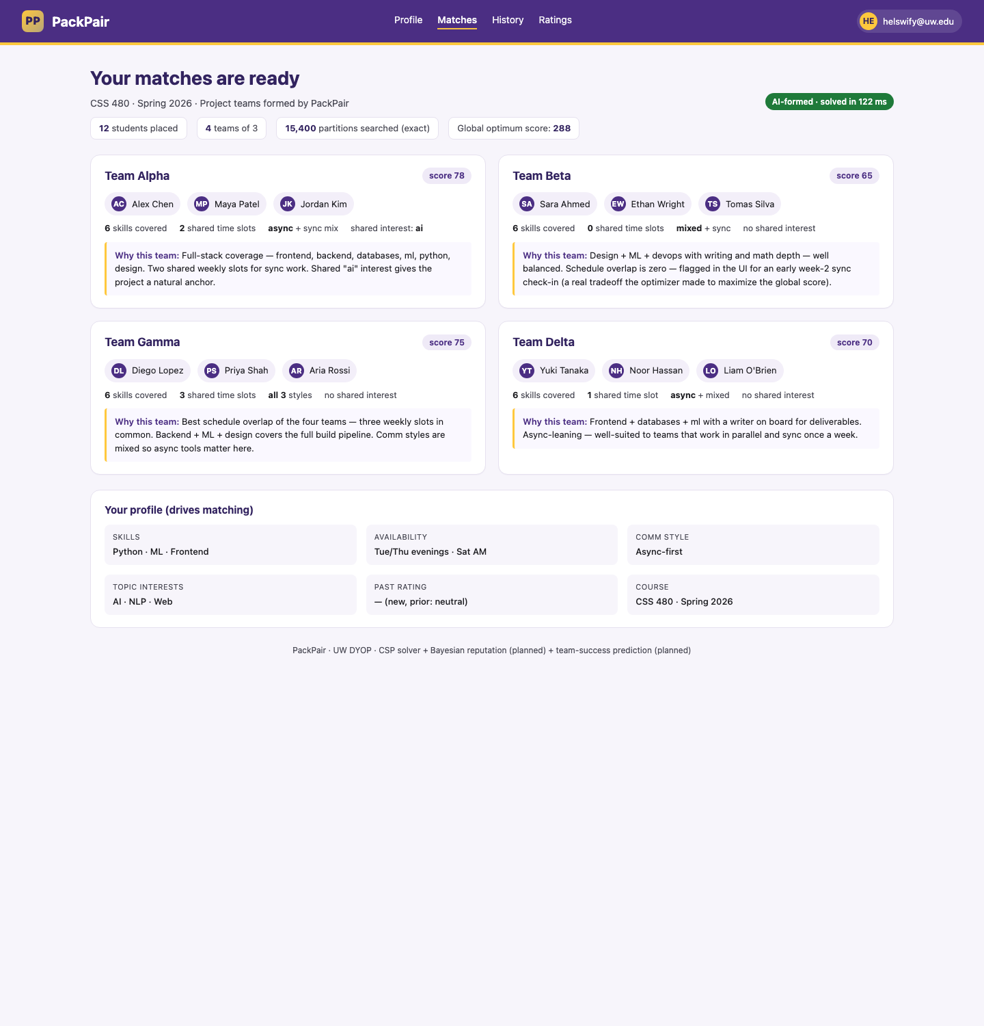
Progress / Demo
Key highlights
• Hi-fi matches page live at the URL below — UW branding + per-team AI rationale
• CSP solver scores on skill diversity + schedule overlap + comm fit — exact optimum over 15,400 partitions in ~120 ms
• Three-layer AI locked in: search (CSP) → Bayesian reputation → supervised team-success prediction
Live demo → https://habibaelswify.github.io/packpair-demo/
Notes:
Here's the demo. On screen is our matches page — the user sees four AI-formed teams, each with the rationale: skills covered, schedule overlap, shared interest. Under the hood, our prototype enumerates every valid partition of the roster — 15,400 of them — and picks the one that maximizes our weighted objective: skill diversity plus schedule overlap plus comm-style fit. At our pilot class size full enumeration is fast enough to be exact; production swaps in OR-Tools CP-SAT to scale up. Three AI layers behind the front end — search, Bayesian reputation, supervised prediction. (~50s)

Slide 4
Blockers & Next Week's Plan
Blockers / Risks
Next Week's Goals
• Cold-start: reputation model has no rating data on day one
• Anti-gaming: 3-person team ratings are re-identifiable
• UW NetID auth: institutional approval timeline unclear
• Bayesian reputation prior (neutral Beta per dimension) for new students
• k-anonymity rolling aggregates as anti-gaming mitigation
• Supabase schema + mock SSO standing up
• First end-to-end slice: profile form → solver → team display
Help needed from instructor:
A contact at UW IT for Shibboleth / NetID test credentials, or guidance on the right intake process.
Notes:
Two real blockers came out of the proposal feedback, plus one institutional one. First, cold-start: reputation model has zero data until students rate each other — addressed with a neutral Bayesian prior that updates as ratings arrive. Second, anti-gaming: three-person ratings are re-identifiable, so we're moving to k-anonymity aggregated over a rolling window. Third blocker — NetID test access for real auth — isn't in our hands, that's where we could use your help. Next week we ship the first vertical slice: profile form, real solver call, team display. (~45s)

Slide 5
Individual Contributions
Student
Hours
What I Worked On This Week
Habiba Elswify
7 hrs
• CSP team-matcher prototype (Python, full-enumeration solver)
• System architecture spec + tech-stack decisions
Aasiya Sathar
7 hrs
• Profile schema design (9 fields → feature vectors)
• Hi-fi mockups (landing, profile, matches) + AI-feedback triage
Team total this week: 14 hrs (target: 5–10 hrs per person ✓)
Cumulative team hours to date: 14 hrs
Notes:
Quick split: I built the CSP prototype and the architecture spec. Aasiya designed the profile schema and the hi-fi mockups, and led the triage of the proposal feedback into our backlog. Seven hours each, fourteen for the team. Thanks — happy to take questions. (~30s)

